Slide 1
R Shiny App: Customer Churn Analysis
Prepared by: Rob Wygant

Slide 2
Overview
Motives
Dataset
Methods
Web application
Future work

Slide 3
Motives
Customer churn is an important business metric
Good understanding and monitoring of this metric can…
help businesses allocate resources to prevent it from happening
better plan for business cycles
improve on current churn rate
The goal of this application is a generic customer churn dashboard to baseline current churn for a customer demographic and then identify categories for improvement.

Slide 4
Customer Churn Dataset
Bank Customer Churn Dataset:
Sourced from Kaggle
Customer data from European bank
10,000 individual customer records
Initially 11 inputs and 1 output
https://www.kaggle.com/datasets/gauravtopre/bank-customer-churn-dataset

Slide 5
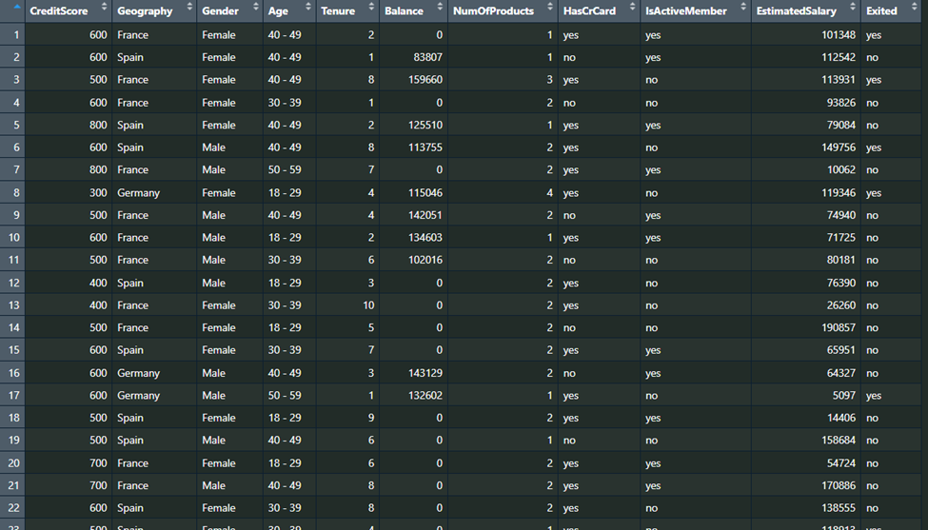
Methods
Transformed several columns to categorical via data binning
Dataset:
Categorical (nominal)
country
gender
credit_card
active_member
Categorical (ordinal)
credit_score
age
tenure
products_number
Numeric
balance
estimated_salary
Removed
customer_id

Slide 6
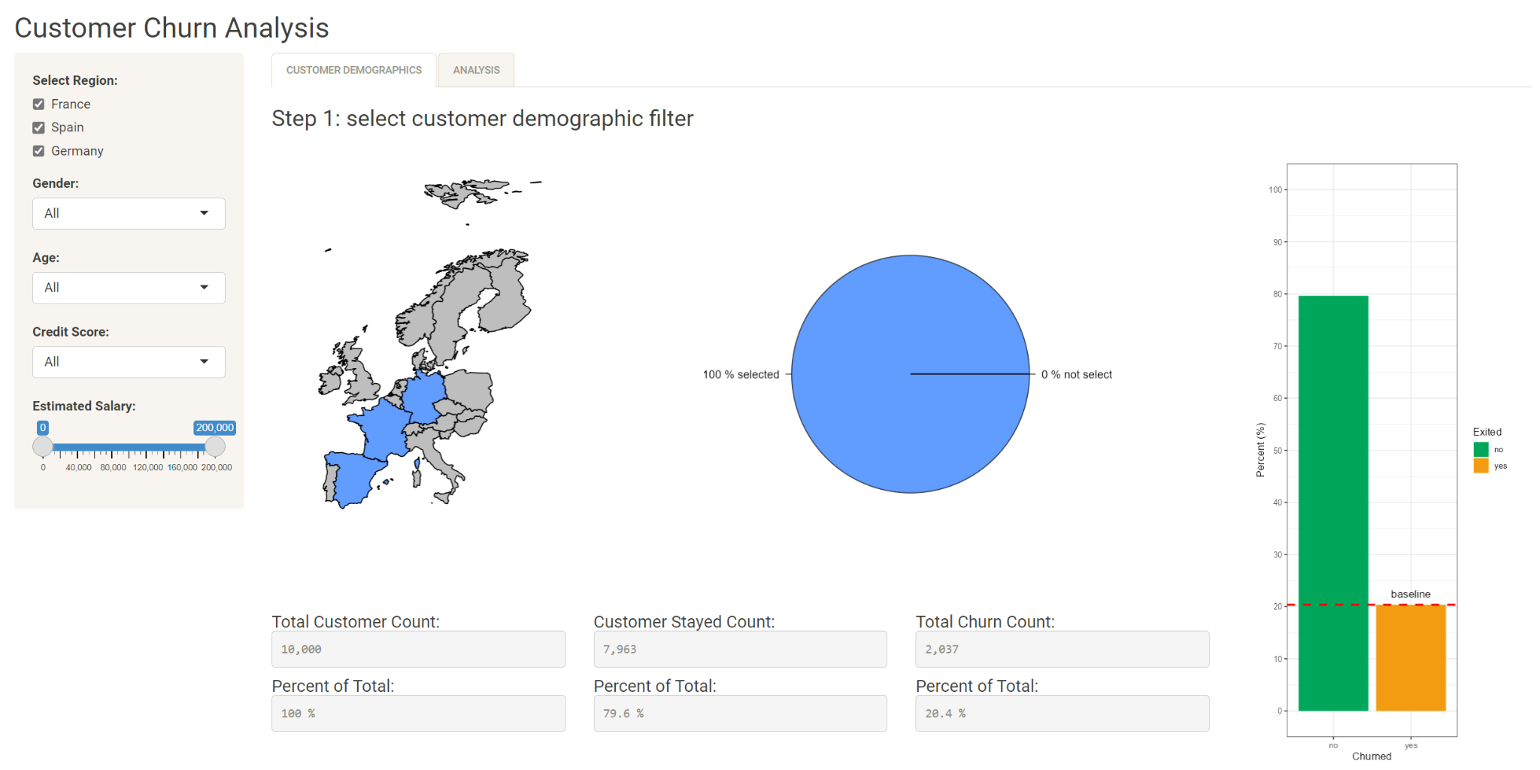
Web application demonstration
Independent variables: filter for customer demographics
Geography
Gender
Age
Credit Score
Estimated Salary
Set baseline

Slide 7
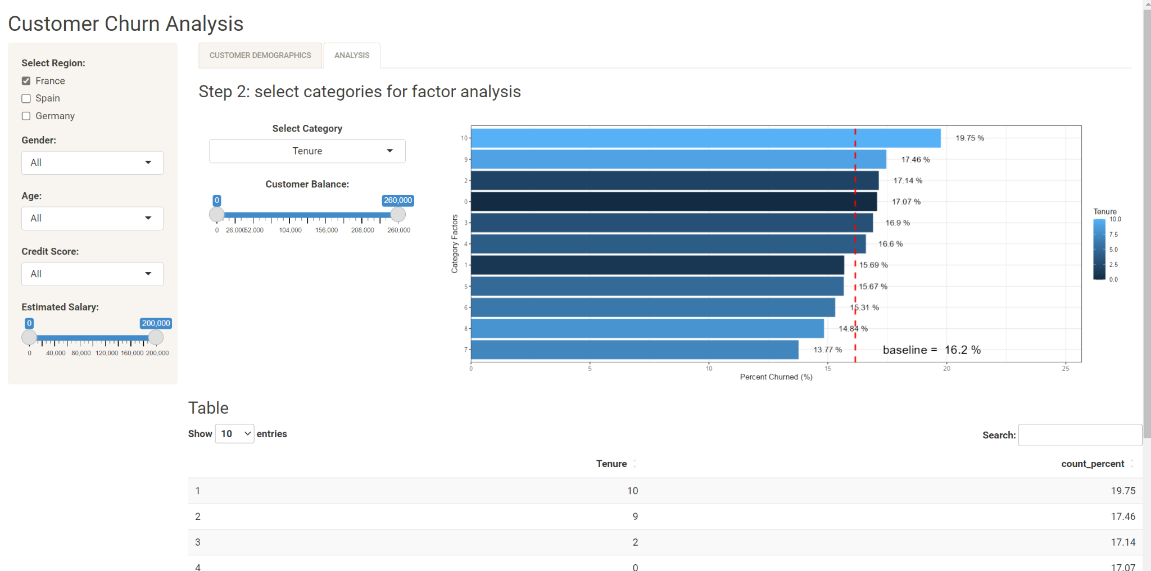
Web application demonstration
Independent variables: internal metrics to target
Tenure
Credit card holder
Number of products
Active member
Outputs category factors percent churned
Compared to original baseline

Slide 8
Future work
Advanced analytics for statistical analysis
Multifactor prediction
Cluster analysis
Multiple linear regression
Design app to handle time series based data inputs

